Slide 1
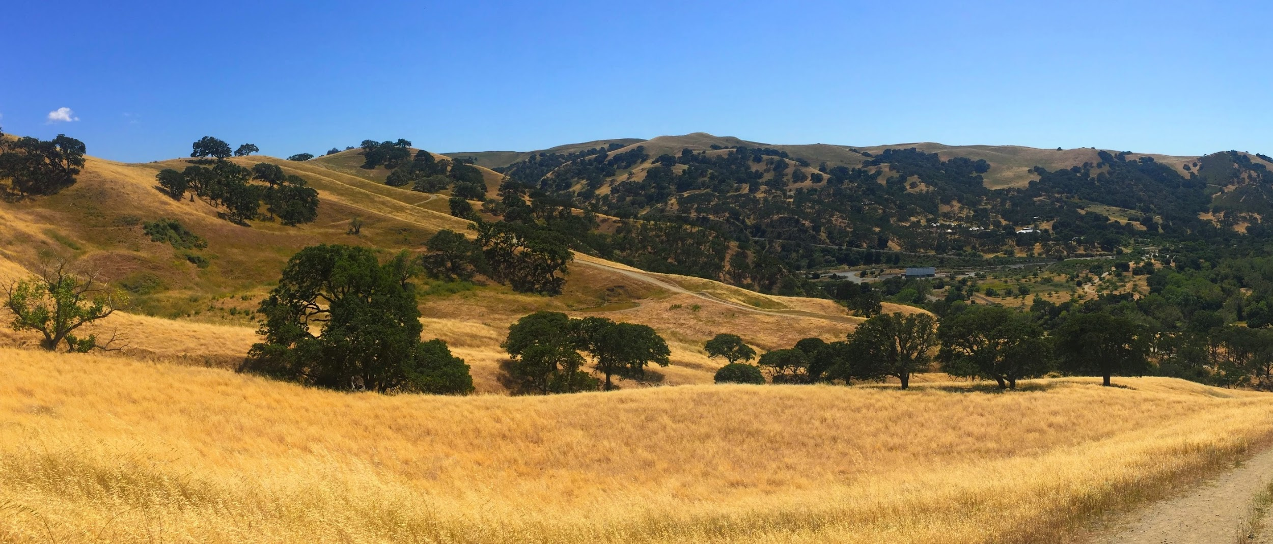
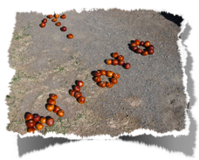
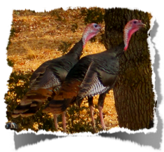
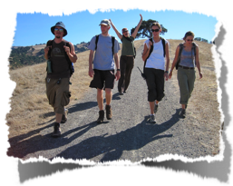
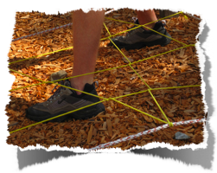
Web of Life Field School at Camp Arroyo

Slide 2
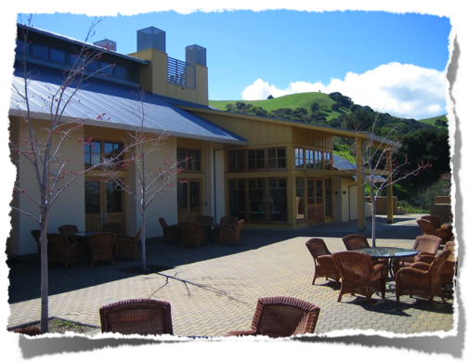
ABOUT CAMP ARROYO
Located in Livermore
Built & Opened in 2001
Managed in partnership with the East Bay Regional Park District and The Taylor Family Foundation
The buildings model various green features

Slide 3
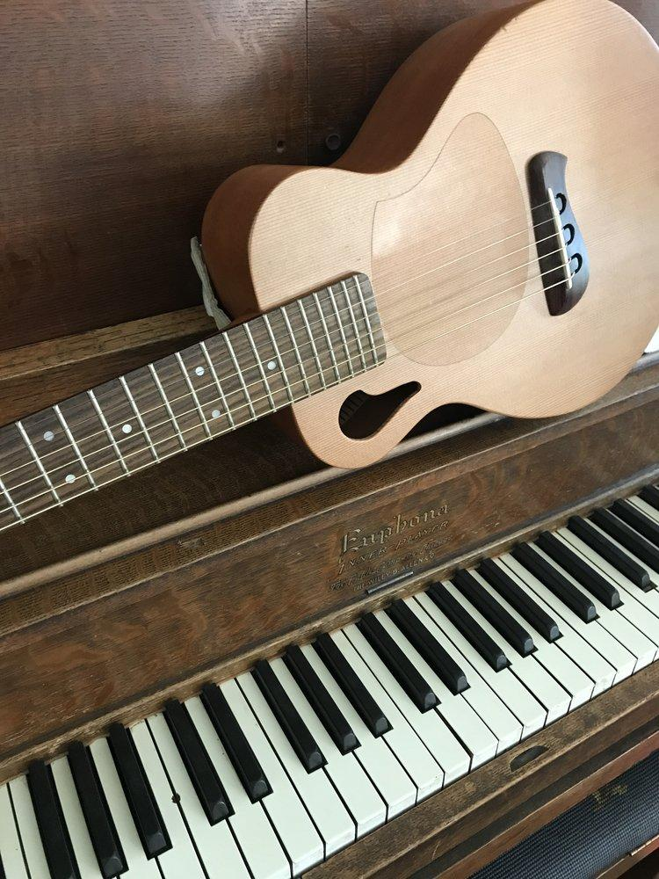
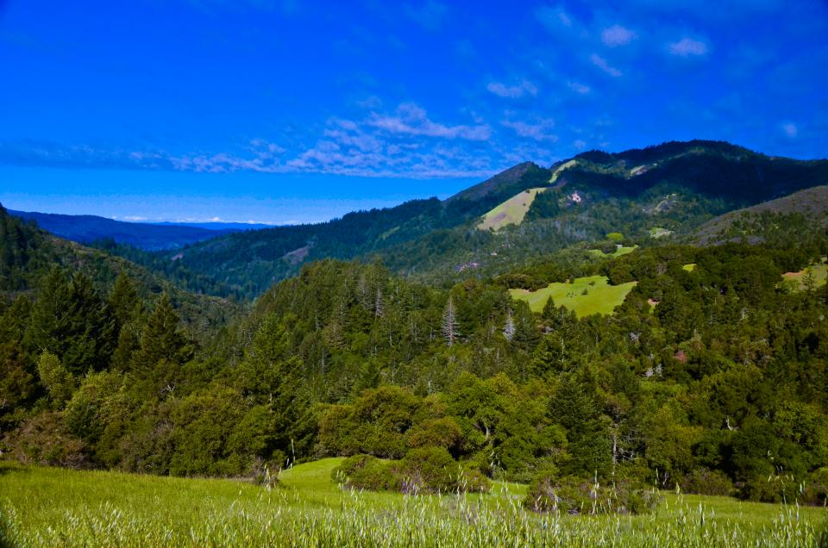
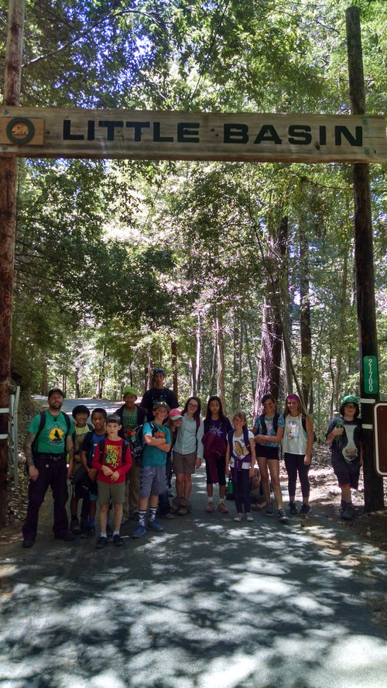
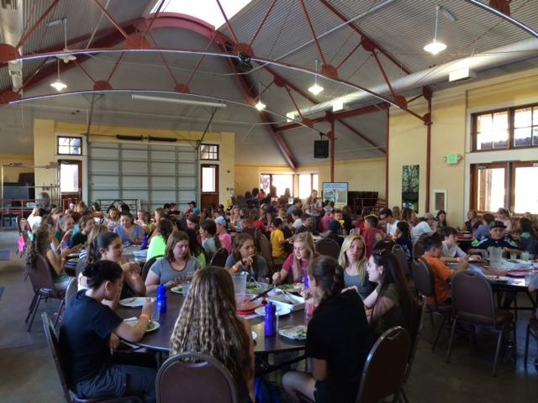
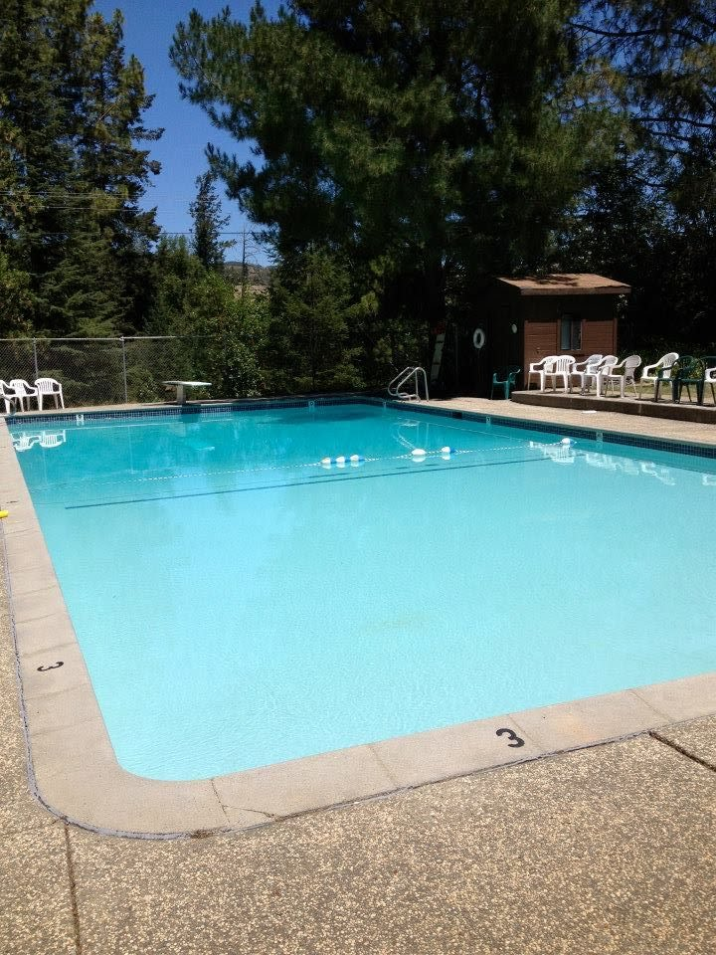
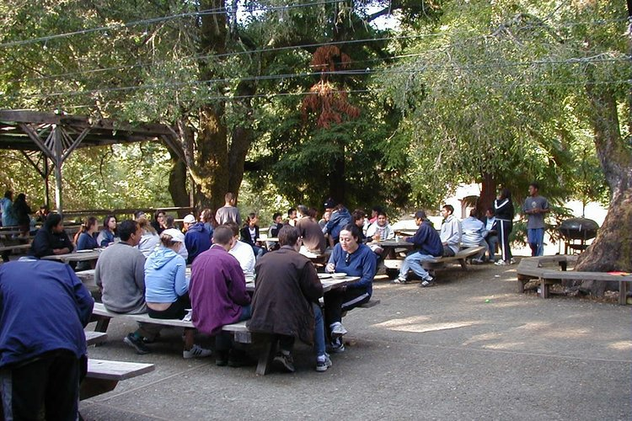
UNITED CAMPS, CONFERENCES AND RETREATS
(UCCR)
Founded in 1970
UCCR’S mission is to create partnerships to provide positive life-changing experiences

Slide 4
WEB OF LIFE FIELD (WOLF) SCHOOL
Founded in 1989
WOLF School’s mission is to build respect, appreciation and stewardship within the Web of Life
Programs explore the 7 concepts of Energy, Cycles, Change, Adaptations, Communities, Interdependence and Diversity
WOLF School is a program of UCCR and serves over 4000 students each year

Slide 5
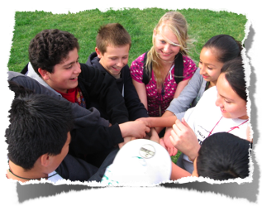
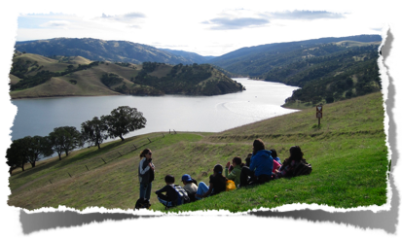
THE BENEFITS OF OUTDOOR SCHOOL. . .
We have hands-on curriculum that meets NGSS & Common Core Standards
Community-building activities at Outdoor School transfer back to the classroom
Personal Growth
Staying overnight, away from home
Working with peers, making new friends
Overcoming personal challenges
Taking on new responsibilities

Slide 6
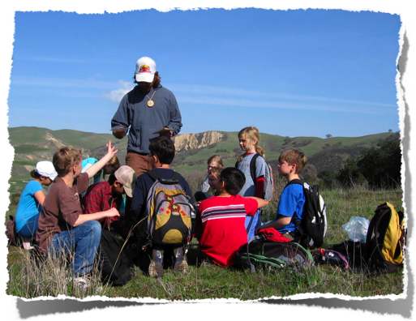
WHAT HAPPENS AT OUTDOOR SCHOOL?
Outdoor Environmental Education Lessons
Focused, hands on learning experience, this is not a “summer camp”
Students will be placed in Adventure Groups by their teachers
WOLF School Naturalists will be the teachers while at Outdoor School
Students will spend their time exploring, hiking, learning, having fun and making new friends

Slide 7
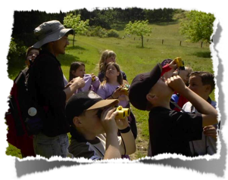
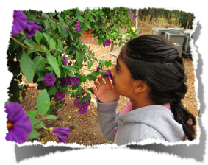
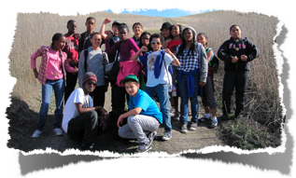
SAFETY & MEDICAL CONCERNS
Students are supervised by adults 24 hours a day
There are 1-2 chaperones per cabin whenever the students are in the cabins
Students are never allowed to go anywhere by themselves. We use a buddy system
All UCCR/WOLF staff and volunteers complete a fingerprint and background screening
All staff are First Aid/CPR certified and trained in use of onsite AED.
All medications are distributed by the Health Supervisor assigned by the school.
Emergency services can be at camp within 10 minutes.

Slide 8
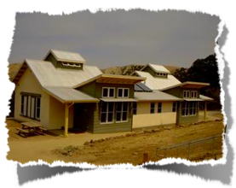
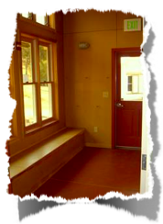
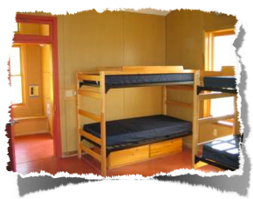
CABINS
-6 male cabins & 6 female cabins
-Each cabin fits 12 people (11 students, at least one adult)
-Each cabin has:
6 bunk beds
Drawers to store clothes
Heat & Air conditioning
A bathroom inside the building

Slide 9
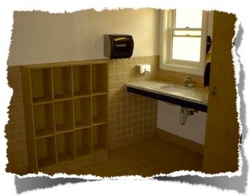
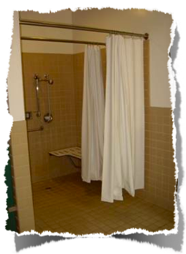
CABIN BATHROOMS
Each bathroom has:
-1 private shower
-1 private toilet
-2 sinks
-Shelves for toiletries

Slide 10
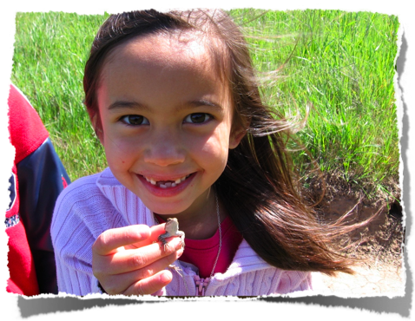
An example of the schedule…

Slide 11
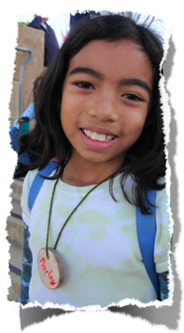
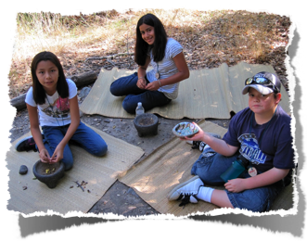
Adventure Group Lessons
Voices
Learn about the Ohlone Native Americans
Explore the Ohlone culture through hands-on activities (making rope, pump drills, shell necklaces, mortar & pestle, and making fire)
Ecosystem Exploration
Explore the natural area of camp using games, activities and scientific tools
Look for critters under logs, use hand lenses and find out what lives in the Oak Savannah
Go on a hike to explore our natural surroundings

