Slide 1
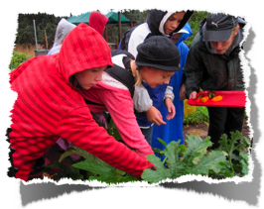
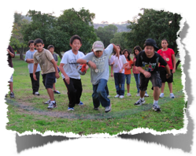
More lessons...
Garden
Harvest & eat seasonal garden produce
Discuss life cycles and see them in action through the composting system
Help out in the garden
Discuss organic vs. conventional gardening
Eco-Awareness
Learn about renewable & non renewable resources
Explore the green buildings at Camp Arroyo
Find out what little things you can do to make a big difference!

Slide 2
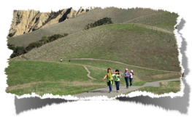
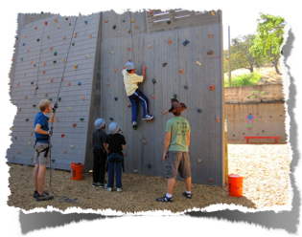
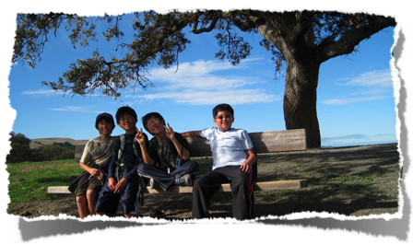
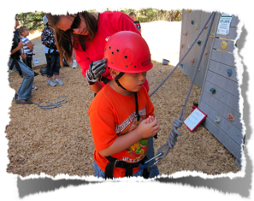
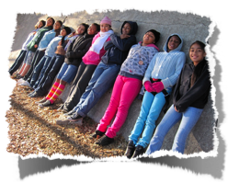
Even more lesson options...
Cresta Blanca
Learn about local geology & watersheds.
Hike to the top of the surrounding hills for an incredible view of Lake Del Valle.
Climbing Wall
Set a goal for yourself at our 35 foot climbing wall
Support your classmates as you all challenge yourselves and expand your comfort zones.

Slide 3
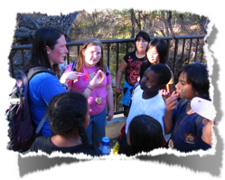
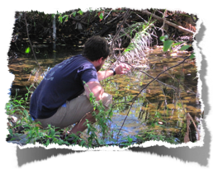
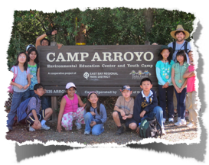
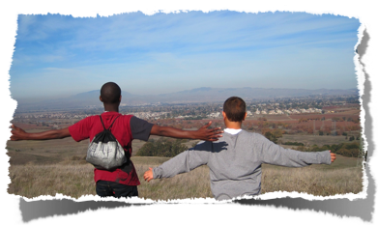
Final lesson option...
Creek Exploration
Learn about water conservation, watersheds, and freshwater ecology
Explore the water cycle
Test the water of the Arroyo Del Valle and look for critters living there.

Slide 4
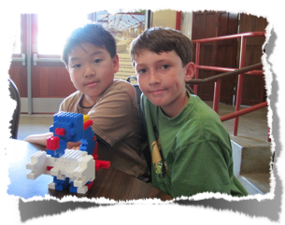
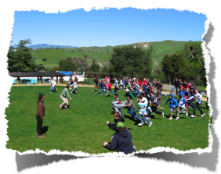
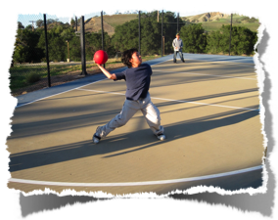
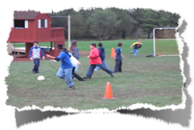
Recreation Time
In the afternoon you can choose
what you want to do for recreation time.
Some options are:
Soccer
Basketball
Paper Airplanes
Board games
and lots of other fun activities!

Slide 5
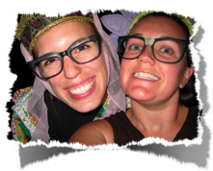
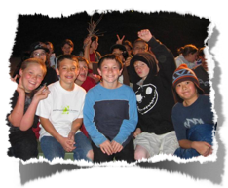
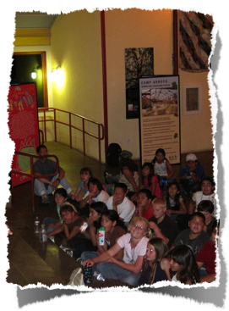
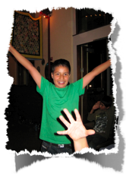
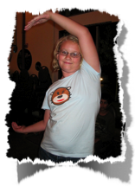
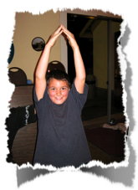
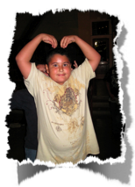
Evening Programs
Include:
Staff Skit Night
Night Hike
Surprise Activity!

Slide 6
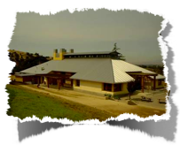
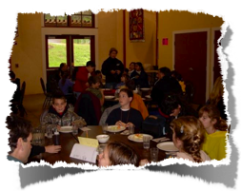
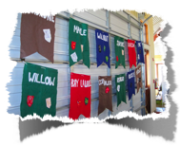
Meals
Students are assigned to a table group for the week & meals in the dining hall are served family style.
3 nutritious and delicious meals are provided each day with plenty of variety to keep everyone happy. Breakfast and Dinner are prepared by our professional kitchen staff, while lunches are packed by the students each day and eaten with their Adventure Group while on trail.
If your child has a food allergy or dietary issue please write it on the health form so that the kitchen can
accommodate your child’s needs.
Meals may include:
Breakfast: pancakes, eggs, fruit, bacon, potatoes, cereal
Lunch: sandwiches with various fixins, chips, fruits and snacks
Dinner: pasta, tacos, vegetables, turkey, mashed potatoes, rice, stir fry

Slide 7
How do Meals work?
At meals in the dining hall we have 3 jobs that everyone has the opportunity to help with:
1. Set up: a different group will set the tables for each meal.
2. Hoppers: each table will have two rotating hoppers per meal. Hoppers bring serving dishes to the table and clear the items at the end of the meal (they are not in charge of serving any food).
3. Clean Up: the cabin groups will rotate through staying after Dinner to sweep the floor so that the dining hall is ready for the next meal or activityl.

Slide 8
Behavior Management
Some of our rules...
Camp Arroyo Four Core Values: Respect, Responsibility, Honesty, Caring
Always follow the Buddy System
Walk on paths
Listen and follow the directions of the teachers and chaperones
Respect the property of others
Respect the privacy of others
Use positive language
Our Warning System:
1st Warning: Verbal
2nd Warning: Will miss Recreation time for the day
3rd Warning: Will miss Recreation Time & will call home
4th Warning: Will be sent home

Slide 9
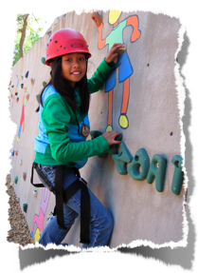
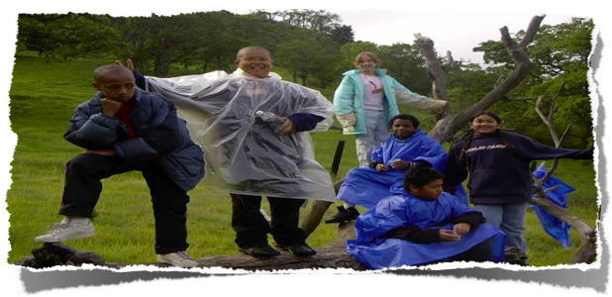
What to bring...
Sack lunch for Arrival Day ONLY
Waterbottle!
Day pack to carry water bottle, sunscreen warm layer on lessons
Sleeping bag OR twin-size sheets and blanket
Pillow
Pajamas (sleeping clothes)
2 pairs of shoes (incase 1 pair gets muddy)
Pants, shirts, jacket, hat
Rain coat or poncho
Toothbrush, toothpaste, shampoo, soap, towel, sunscreen, chapstick

Slide 10
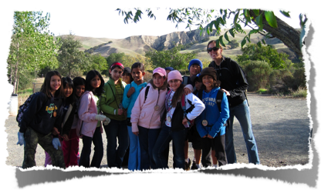
What NOT to bring...
Sandals- students must wear closed toed shoes outside of cabins
Food, gum, candy- it will attract critters.
Swiss army knives
-Electronics- i-pod, DVD player, etc.
Cell phones - there are phones at camp for emergencies.

Slide 11
We look forward to seeing you at Web Of Life Field School at Camp Arroyo!
Camp Arroyo is owned and maintained by East Bay Regional Park District and is managed in partnership with the Taylor Family Foundation and United Camps, Conferences and Retreats.

